Slide 1
International Business
22MBA401
CORE SUBJECT
                Course Coordinator:
                Prof. Madhunayaka
                Assistant Professor,
                Department of MBA,
                VVIET , Mysuru

Slide 2
Module-2 (7Hours)
International Business Environment: Introduction, Meaning and Components of International Business
Environment, Political Environment, Legal Environment, Economic Environment, Technological
Environment, Socio and Cultural Environment, Ethics in International Business and CSR in International
Business.
Contents of MODULE - 2

Slide 3

International Business Environment: Introduction, Meaning
The international business environment (IBE) encompasses all the external factors that influence a company's operations across borders. It's a complex interplay of economic, political, legal, and cultural elements that significantly shape how businesses function on a global scale. Understanding and adapting to this environment is crucial for success in international markets.
International business environment is regarded as the “sum of all the external forces working upon the firm as it goes about its affairs in foreign markets”.

Slide 4
Importance of International Business Environment
Dependency of Industry on Import and Export
Spread Effects of the International Development
Increasing Complexities of Business Environment
To Anticipate and Withstand Changes of the Business World

Slide 5
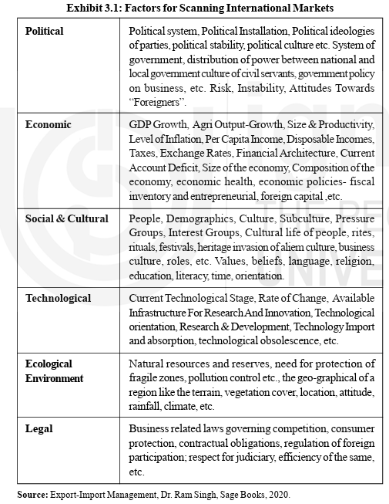
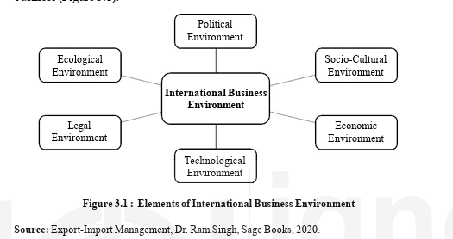
Components of International Business
Environment

Slide 6
Political Environment,
Government activities and actions that influence the daily business operations of a company or business constitute the political environment.
Political System
A political system can be defined as a system of government and politics.
Political System as the Basis
  Parliamentary Governments
  Absolutist System
  Number of politics parties can also be used as a toll to classify the governments.
  Two party system, 2. Multiparty System, 3. Single party, 4. Dominated One party.
Economic System as the Basis
a. Communist Theory
b. Socialism Theory
c. Capitalism Theory

Slide 7
Political Environment,
Influence of Political Environment on International Business
Political Ideology of the Government
Political Stability in the Country
Government Relations with other Countries
Defense and Military Policy
Thinking of Opposition Parties towards Business
Policies towards International Marketing
Government Control and Restrictions

Slide 8
Legal Environment
The Policies, laws and regulations formulated by the government for conducting the business operations constitute the legal environment of the country.
Global Marketing is affected by the following three bodies of law
International Laws
Host-Country Laws
Home-Country Laws
Legal Factors Affecting International Business
Bribery
Decision Regarding Branch or Subsidiary
a. Branch
b. Subsidiary
3. Counterfeiting (Duplicate)
4. Strategic Concerns
5. Gray/Grey Market

Slide 9
Legal Environment
Influence of Legal Environment on International Business
Deregulation
Globalization
Concern for Natural Environment
Intellectual Property
Product Liability and Safety
Competition among Business
Bribes and Corrupt Practices
Advertising and Sales Promotions
Contracts

Slide 10
Economic Environment
Economic environment refers to those economic factors which largely influence the functioning of a global business organization in any country. These factors consist of production process and wealth distribution system prevalent in countries.
Determinants of Economic Development
Economic factors in Economic Development
a. Capital formulation
b. Natural Resources
c. Marketable Surplus of Agricultural
d. Conditions in Foreign Trade
e. Economic System
2. Non-Economic Factors in Economic Development
a. Human Resource
b. Technical Know-How and General Education
c. Political Freedom
d. Social Organization
e. Corruption
f. Desire to Develop

Slide 11
Economic Environment
Influence of Economic Environment on International Business
Changing Income
Changing Consumer Spending Patterns
Changing Economic Conditions

Slide 12
Technological Environment
Technology is a systematic applications of scientific or other organized knowledge to practical task.
Features of Technological Environment
Constituent of Macro Environment
Far Reaching Effects
Different from Science
Change
Prevalent
Self-Reinforcing
Influence of Technological Environment on International Business
Influence of Technology on Society
Economic Effects of Technology
Technology and Root Level Alterations

Slide 13
Socio and Cultural Environment
Factor Constituting Cultural Difference
Time
Patterns of Thought
Personal Space
Family Roles and Relationships
Language
Religion
Personal Achievement
Competitiveness and Individuality
Social Behavior
Ethnocentric Attitude
Flexibility and Sincerity
Intercultural Socialization

Slide 14
Socio and Cultural Environment Environment
Importance of Socio-Cultural Environment in International Business
National Taste
Language
Values and Beliefs
Demography
Literacy Rate
Female Workforce
Double Income Families
Impulse Buying

Slide 15
Socio and Cultural Environment Environment
Influence of Cultural Environment on International Business
Cultural Determines Goods and Services
Culture Determines Attitude to Work
Culture and Global Business
Culture and Competitive Advantage
Culture and Strategy

Slide 16
Ethics in International Business
“Business ethics is the study of complex business practices and behaviors that give rise to ethical issues in organizations.”
Ethical Issues in International Business
1. Export Subsidies
2. Bio-Piracy
3. Safety and Environmental Issues
4. Issues of Corruption
5. Issue of Consumerism
6. Issues of Transfer Pricing

Slide 17
Ethics in International Business
Importance of International Business Ethics
Ethics corresponds to Basic Human needs
Ethics and Profit go together
Law cannot protect Society, Ethics can
Ethics Facilitates Better Decision Making
Ethics Improves Cooperation
Ethics Promotes Moral and Social Values

Slide 18
CSR In International Business
“The Concept of Corporate Social Responsibility or social responsibility is gaining significant prominence for national as well as international business.”
Tools of Corporate Social Responsibility
Accountability
Codes of Conduct
Fair Trade
Social Accountability
Socially Responsible Investing
Global Reporting

Slide 19
CSR In International Business
Arguments for Corporate Social Responsibility in MNCs
Changed Public Expectation of Business
Better Environment for Business
Public Image
Avoidance of Government Regulation
Balance of Responsibility with Power
Business has the Resources
Let Business Try
Moral Responsibility
Citizenship Argument
Duty of Gratitude
Prevention is Better than Cure

Slide 20
CSR In International Business
Argument against Corporate Social Responsibility in MNCs
Profit Maximization
Society has to pay the cost
Lack of Social skills
Business has enough power
Social Overhead Cost
Lack of Accountability
Lack of Broad Support

Slide 21
Thank You
Emerging Trends in Marketing

